Slide 1
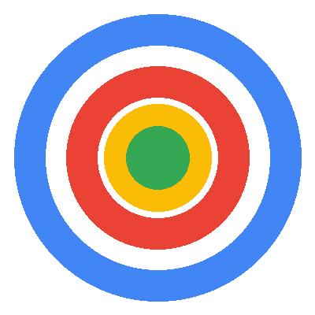
Specialist Focus
Dental & Aesthetics PPC
DRIVING PATIENT ACQUISITION
Direct experience managing campaigns for dental clinics and cosmetic practices
16 Years
100+
£50M+
Dental by Design | Prodent Group
Hands-On Google Ads
Accounts Managed
Total Spend
Christopher Hoole
Google Ads Specialist | April 2026
christopherhoole.com
Performance Marketing Specialist | Interview Presentation

Slide 2
About Me
christopherhoole.com
16 Years
100+
£50M+
6 Levels
In Paid Media (Since 2009)
Accounts Managed
Total Spend Managed
ACT Optimization Engine
Key Credentials
Hands-on platform specialist — I work inside Google Ads and Meta daily. Not a strategist who delegates to juniors.
Direct dental & aesthetics PPC experience — managed campaigns for a cosmetic dental clinic and Medizen Aesthetics (medically-led cosmetic clinic, Birmingham).
Built ACT (Ads Control Tower) — a proprietary Google Ads optimization engine with 30+ automated checks across Account, Campaign, Ad Group, Keyword, Ad, and Shopping levels.
Notable clients: Lexus, Toyota, Virgin Media O2, Destinology, SixStarHolidays, Select Property Group.
Managed budgets from £5,000 to £400,000 per month across competitive B2C markets.
Key results: 63% CPA reduction at Destinology (£120 to £45). Grew B2B leads from 0 to 2,000/month at Virgin Media O2.
This is not a strategy-only profile. Every role I've held has been hands-on, in-platform, accountable for results.
Christopher Hoole | christopherhoole.com | Confidential
2

Slide 3
Relevant Experience — Dental & Aesthetics
Competitive B2C Lead Gen
Direct experience in the same market dynamics as Dental by Design
Cosmetic Dental Clinic (via PodDigital)
Medizen Aesthetics (Birmingham)
Google Ads for a cosmetic dental practice — implants, veneers, cosmetic treatments
Generated patient enquiries in a competitive local market with high CPCs (£5-15+)
Full search campaign management, bid strategy optimization, negative keyword framework
Confidential — active agency client (can discuss approach and results in conversation)
Medically-led cosmetic clinic — injectable treatments, laser procedures, aesthetic services
High-value patient leads in a competitive B2C market
Search-led campaigns targeting treatment-specific intent
Focus on lead quality over volume — CPA reduction through audience and landing page optimization
Why This Matters for Dental by Design
Same Patient Journey
Same Cost Dynamics
Same Success Metrics
Search intent → ad click → landing page → enquiry form → booking. I know what makes someone click and what makes them convert.
High CPCs (£5-15+), long decision cycle, price-sensitive patients, quality vs cost trade-offs. Every wasted click is expensive.
Patient enquiries that convert to bookings — not clicks, not impressions. Lead quality matters more than volume.
Christopher Hoole | christopherhoole.com | Confidential
3

Slide 4
Case Study — Account Audit & Turnaround
Anonymised Client
A UK professional services business — the methodology I would apply to your account
42.7%
£20-25
of budget wasted — £7,836 of £18,338 total spend identified as waste
Target CPA achieved (down from £38) — a 35-48% reduction in cost per lead
Issue Found | Impact
No target CPA set | Algorithm spending unchecked — CPA peaked at £65
Conversion tracking inflated | Micro-conversions counted as leads — misleading data
Quality Scores of 2-3 / 10 | Paying 2-4x premium on every click
Negative keyword gaps | Irrelevant traffic consuming 42.7% of budget
Auto-apply recommendations on | Google making unsupervised bid strategy changes
What I Recommended
Campaign restructure by service type — tighter ad groups for better Quality Scores
Set proper target CPA — gave the algorithm a cost guardrail
Negative keyword framework — 9 organised lists (phrase + exact match)
Ad copy A/B testing — 3 RSA variants testing different messaging angles
Disabled auto-apply — stopped Google making unsupervised changes
This is exactly the audit I would run on your Google Ads and Meta accounts in week 1. Same methodology, same rigour, same focus on measurable results.
Christopher Hoole | christopherhoole.com | Confidential
4

Slide 5
My Approach — Week 1 at Dental by Design
First 5 Days
I don't wait 3 months to show results. Week 1 delivers measurable improvements.
Days 1-2
Days 3-4
Day 5
Full Account Audit
Competitive Landscape
Quick Wins — Live
Deep-dive into Google Ads + Meta account structure
Audit bid strategies, conversion tracking, search terms
Analyse negative keywords, Quality Scores, ad copy
Benchmark CPL, CPA, conversion rates per clinic
Research competitor bidding — keywords, ad copy, landing pages
Identify gaps in the dental implant keyword space
Map high-intent search terms competitors are targeting
Assess USP positioning (integrated model, pricing advantage)
Fix conversion tracking issues found in audit
Add negative keywords to block wasted spend immediately
Set proper target CPA / ROAS guardrails
Pause underperforming campaigns or ad groups
Deliverable: Full audit report with findings, quick wins, and 90-day roadmap — by end of week 1
Christopher Hoole | christopherhoole.com | Confidential
5

Slide 6
Months 1-3 Roadmap
90-Day Plan
Targeting 20-30% CPL reduction within 90 days based on experience with similar accounts
Month 1
Month 2
Month 3
Foundation & Restructure
Optimise & Expand
Scale & Benchmark
Restructure campaigns by treatment type (implants, cosmetic, general, emergency)
A/B test ad copy — treatment-specific messaging angles
Implement ad schedule + device bid adjustments based on data
Launch negative keyword framework (9 shared lists per account)
Fix conversion tracking — count real patient leads only
Landing page analysis + conversion rate optimization
Refine audience targeting on Meta (lookalikes, remarketing)
Expand keyword coverage from search term mining insights
Quality Score improvement (ad relevance + landing page experience)
Begin multi-clinic rollout — adapt messaging per practice
Scale winning campaigns — increase budget on best performers
Cut underperformers — reallocate spend to proven winners
Establish performance benchmarks per clinic (CPL, CVR, CPA)
Full transparent reporting framework — monthly reports for each clinic
Strategic roadmap for months 4-6 based on Q1 data
Christopher Hoole | christopherhoole.com | Confidential
6

Slide 7
Understanding Your Market
Market Analysis
The dental implant PPC landscape — and how your integrated model gives you an edge
Market Factor | Implication for Campaign Management
CPCs £5-15+ per click | Every wasted click is expensive. Precision targeting and negative keywords are critical.
Long patient decision cycle | Patients research extensively before committing to implants (£1,695-£15,990+). Remarketing is essential.
Lead quality > volume | 100 low-quality enquiries cost more than 20 high-intent patients. Structure must filter intent.
Intense local competition | Harley Street clinics, NHS alternatives, dental tourism. Messaging must differentiate.
Price sensitivity | Patients compare costs. Your pricing advantage must be prominent in ad copy and landing pages.
Your Competitive Advantage
Integrated Model — Clinic + Lab + Manufacturer = control over quality AND pricing. No other London competitor can match this.
"Up to 60% Less" — A powerful ad copy hook. Price-sensitive patients will click — and your quality keeps them.
Vivo Bridge — 48hrs — "Permanent teeth in 48 hours" is an incredible USP. Speed + quality + price = unbeatable.
4.8★ / 399+ Reviews — Social proof in ad extensions and landing pages dramatically improves CTR and conversion rates.
Multi-Clinic Network — Scale advantage — learnings from Dental by Design benefit every partner clinic nationwide.
I would leverage your integrated model in every ad, every landing page, and every campaign. It's your strongest differentiator in a crowded market.
Christopher Hoole | christopherhoole.com | Confidential
7

Slide 8
Multi-Clinic Campaign Management
Network Strategy
How I would structure campaigns for Dental by Design + your partner clinics
Element | Approach
Campaign structure | Separate campaigns per clinic — tailored messaging, budgets, and targeting for each local market
Ad group structure | Treatment-level groups (Implants, Cosmetic, General, Emergency) — matching search intent precisely
Negative keywords | 9 shared lists by word count + match type. One blocked term benefits every clinic instantly.
Reporting | Centralised dashboard with clinic-level breakdown — one view of the entire network
Budget allocation | Performance-based — best-performing clinics earn more budget. Underperformers get optimised first.
The Network Effect
Each clinic gets individual attention, but benefits from the collective data. When one clinic discovers a winning ad copy angle, keyword, or negative keyword — it gets rolled out across the entire network.
Shared Learnings
Dental by Design generates the most data — it will be the testing ground. Proven strategies then scale to partner clinics with localised messaging.
Indicative KPI Targets
20-30%
Baseline →
Weekly
CPL Reduction (90 days)
Clinic Benchmarks (Month 3)
Reporting Cadence
Christopher Hoole | christopherhoole.com | Confidential
8

Slide 9
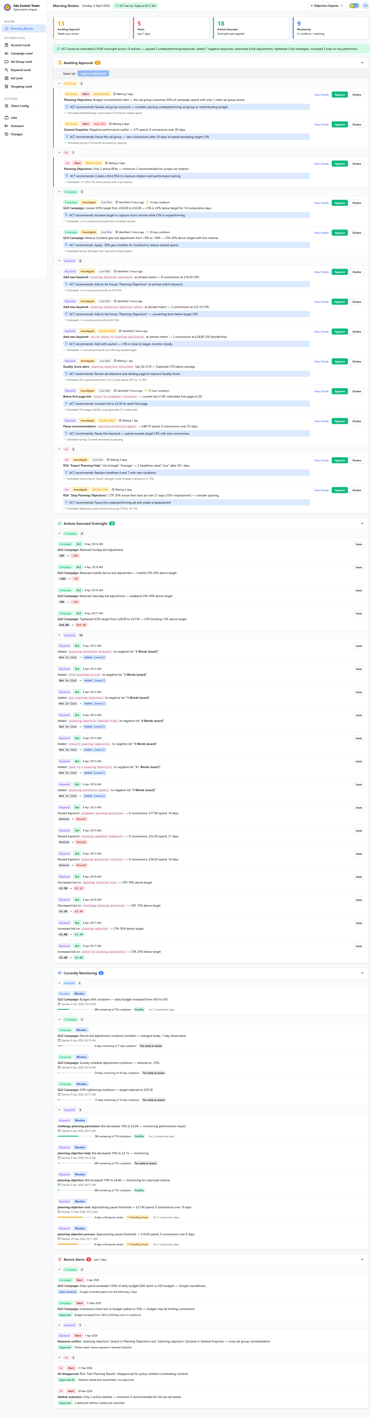
ACT — My Competitive Edge
Proprietary Platform
A proprietary Google Ads optimization engine I built from the ground up
What ACT Does
ACT Morning Review Dashboard
30+ automated checks — running overnight across all campaign elements
6 optimization levels — Account, Campaign, Ad Group, Keyword, Ad, Shopping
7 bid strategy rule sets — Manual CPC, tCPA, tROAS, Max Conv, Max Clicks, PMax, Shopping
Negative keyword engine — Auto-sorts into 9 standardised lists by word count + match type
Morning review dashboard — Shows exactly what needs attention — nothing gets missed
Human-in-the-loop — Every action logged, explainable, and reversible
"I don't just manage campaigns — I've built a system that continuously optimises them. Your campaigns are being refined 24/7, not just when I log in. No other candidate has this."
Christopher Hoole | christopherhoole.com | Confidential
9

Slide 10
Why Me
Summary
1
Hands-On Specialist You get direct access to the person making decisions and executing changes. I work inside the platforms daily — no juniors, no delegation, no layers.
2
Direct Dental & Aesthetics Experience I've managed PPC for cosmetic dental clinics and aesthetic practices. I understand patient decision cycles, high CPCs, and the difference between a click and a booking.
3
Proprietary Optimization Platform No other candidate has built their own Google Ads optimization engine. ACT automates repetitive optimization so I can focus on strategy and growth for your clinics.
4
Proven Audit Methodology My audit process (waste analysis → structure review → restructure plan) has been proven with real clients. 42.7% waste identified, CPA reduced by 35-48%.
5
Results-Focused Commercial Thinking I measure success by patient enquiries and bookings, not impressions and clicks. Your integrated model is a competitive advantage I know how to leverage.
Christopher Hoole | christopherhoole.com | Confidential
10

Slide 11
Ready to Start Immediately
Christopher Hoole
NEXT STEPS
chris@christopherhoole.com
christopherhoole.com
+44 7999 500 184
1
Grant me access to your Google Ads and Meta accounts
Read-only access is all I need to run the full audit
16 Years
Dental PPC
ACT Engine
I'll deliver a full audit report within the first week
Hands-On Experience
Direct Experience
Proprietary Platform
2
Waste analysis, structure review, and restructure plan — same methodology as the case study
"I don't just manage campaigns. I've built a system to continuously optimise them. I have direct dental PPC experience. And I'm ready to start immediately." — Christopher Hoole
3
You'll see measurable improvements within 30 days
Quick wins in week 1, structured optimization in months 1-3, benchmarks by month 3

